Slide 1


CSE 470 – Agile Methodology
BRAC University

Slide 2
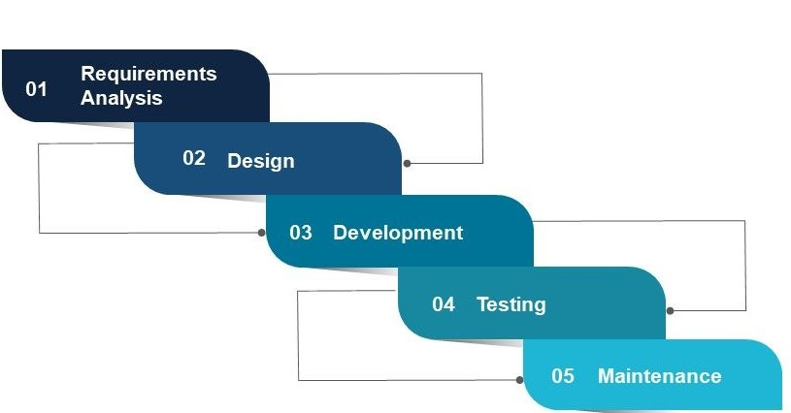
Why we need Agile
1. Monolithic Software: The ready product comes at the end of the process. Now a days, the requirement of software changes frequently, even it can change a number of times in a day.
2. For live systems, like Amazon, Facebook a few seconds of downtime can cause a lot. Changes in such cases needs to be smooth enough so that customers interaction do not interrupt.
Login
Database
Mail
Messaging
Read to know more about Monolithic architecture: click here

Slide 3
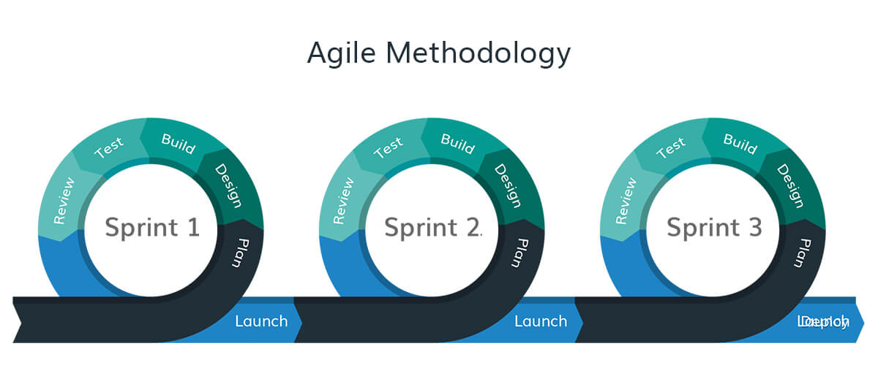
What is ‘Agility?’
Agile is a set of principles and values. It is a practice to be followed.
Agile is a combination of Iterative and Incremental process models with focus on process adaptability and customer satisfaction by rapid delivery of working software.

Slide 4
Agile Manifesto
We are uncovering better ways of developing software by doing it and helping others do it.
Individuals and interactions over processes and tools
Working software over comprehensive documentation
Customer collaboration over contract negotiation
Responding to change over following a plan

Slide 5
Agile Methodologies
Extreme Programming
Agile Unified Process (Excluded for Summer 25)
Scrum

Slide 6
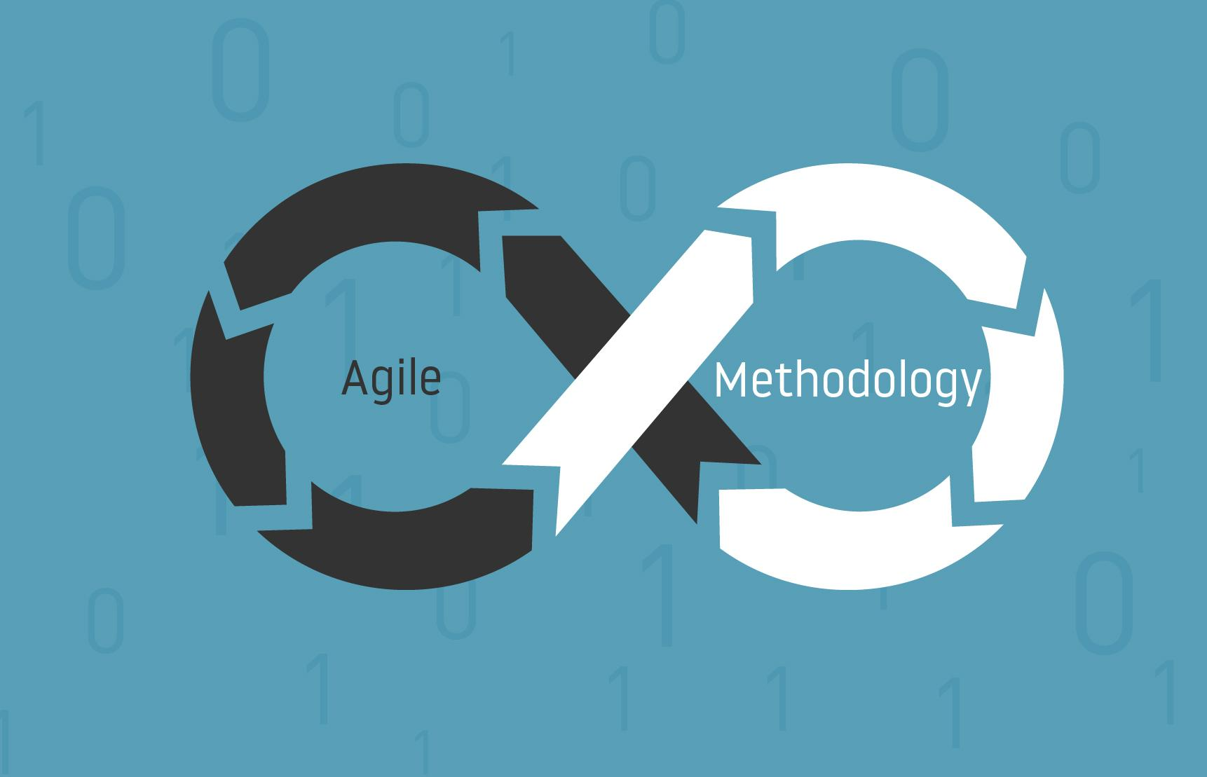
Extreme Programming
In short also known as XP
New versions may be built several times per day
Increments are delivered to customers every 2 weeks
All tests must be run for every build and the build is only accepted if tests run successfully.
Notes:
The initial step in the AUP is the model workflow which begins with the Inception phase. Here project scope, risks, costs and schedule, and project feasibility are defined, including the preparation for the project environment.
The requirement's phase includes identifying the stakeholders, understanding the user's problem, establishing a basis of estimation, and defining the user interface for the system. Although these activities occur during the Inception and Elaboration phases, they can continue through other phases to improve the unfolding design.
During the construction phase, user stories are implemented and iteratively reworked to reflect the expanding understanding of the problem domain as the project progresses

Slide 7
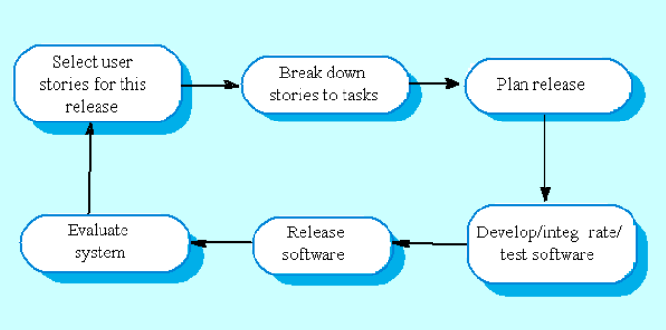
XP Workflow

Slide 8
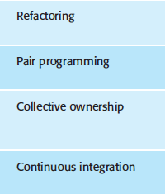
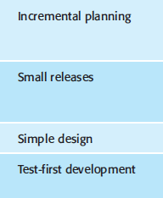
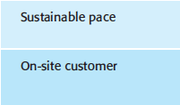
XP Principle or Practice

Slide 9

Pair Programming
Two people code in share, they switch roles from observer to -navigator frequently
Observing code produces better code, so less business cost.
Support each other, better chance for learning.

Slide 10
Unit Testing
Writes unit test for each method to identify problems and resolve it
Test First Development (TFD) is used to ensure better code quality and less error. It refers to write test code first and after that write the development code.

Slide 11
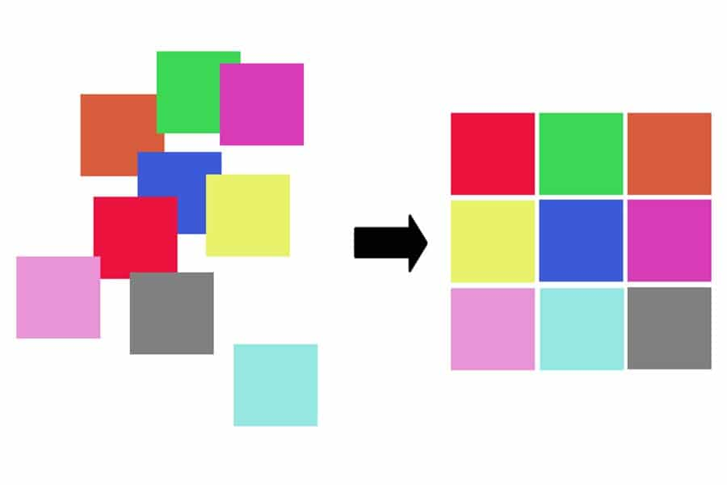
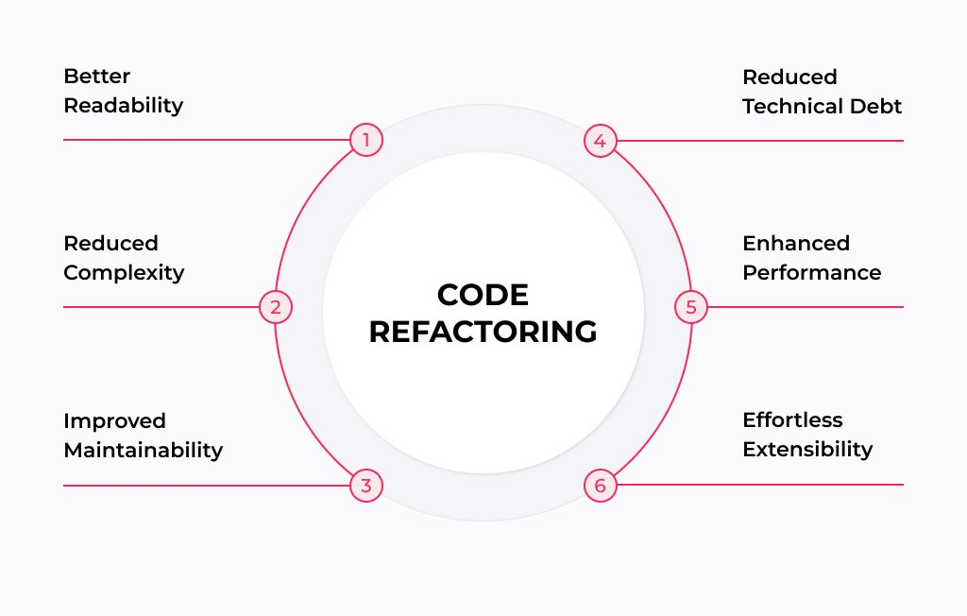
Refactoring
It’s a technique for restructuring existing code by changing its internal structure without changing its external behaviour.
Refactoring includes reducing duplicate codes, breaking long classes/methods into small ones, appropriate variable naming and many more.
It is done for requirement change, improving design and easy extensibility of software.

Slide 12
Agile Unified Process
Another Agile Software Development Methodology
Agile Unified Process (AUP) is a simplified version of the Rational Unified Process (RUP).
Notes:
The initial step in the AUP is the model workflow which begins with the Inception phase. Here project scope, risks, costs and schedule, and project feasibility are defined, including the preparation for the project environment.
The requirement's phase includes identifying the stakeholders, understanding the user's problem, establishing a basis of estimation, and defining the user interface for the system. Although these activities occur during the Inception and Elaboration phases, they can continue through other phases to improve the unfolding design.
During the construction phase, user stories are implemented and iteratively reworked to reflect the expanding understanding of the problem domain as the project progresses

Slide 13
AUP Phases
Inception
Try to identify the business scope of the project, initial requirements and potential solution of the problem.
Elaboration
Design and prove the solution architecture, more requirements can be extracted
Construction
Continuous implementation and testing (specially unit testing) in form of iterations
Transition
Lastly, deploy the system in production environment and adjust feedbacks.

Slide 14
AUP Disciplines
Model
Implementation
Test
Deployment
Configuration Management: Manage access to project artifacts/versions. This includes not only tracking artifact versions over time but also controlling and managing changes to them.
Project Management: Direct the activities that take place within the project. This includes managing risks, directing people (assigning tasks, tracking progress, etc.), and coordinating with people and systems outside the scope of the project to be sure that it is delivered on time and within budget.
Environment: Support the rest of the effort by ensuring that the proper process, guidance (standards and guidelines), and tools (hardware, software, etc.) are available for the team as needed.

Slide 15
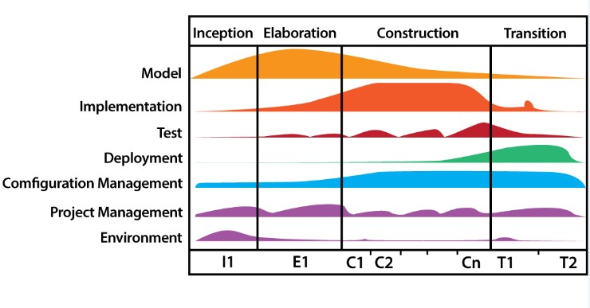

Slide 16
Scrum
It is the most widely used Agile S/W development method for project management
The full software is delivered in 1-4 weeks iterations
Notes:
The initial step in the AUP is the model workflow which begins with the Inception phase. Here project scope, risks, costs and schedule, and project feasibility are defined, including the preparation for the project environment.
The requirement's phase includes identifying the stakeholders, understanding the user's problem, establishing a basis of estimation, and defining the user interface for the system. Although these activities occur during the Inception and Elaboration phases, they can continue through other phases to improve the unfolding design.
During the construction phase, user stories are implemented and iteratively reworked to reflect the expanding understanding of the problem domain as the project progresses

Slide 17
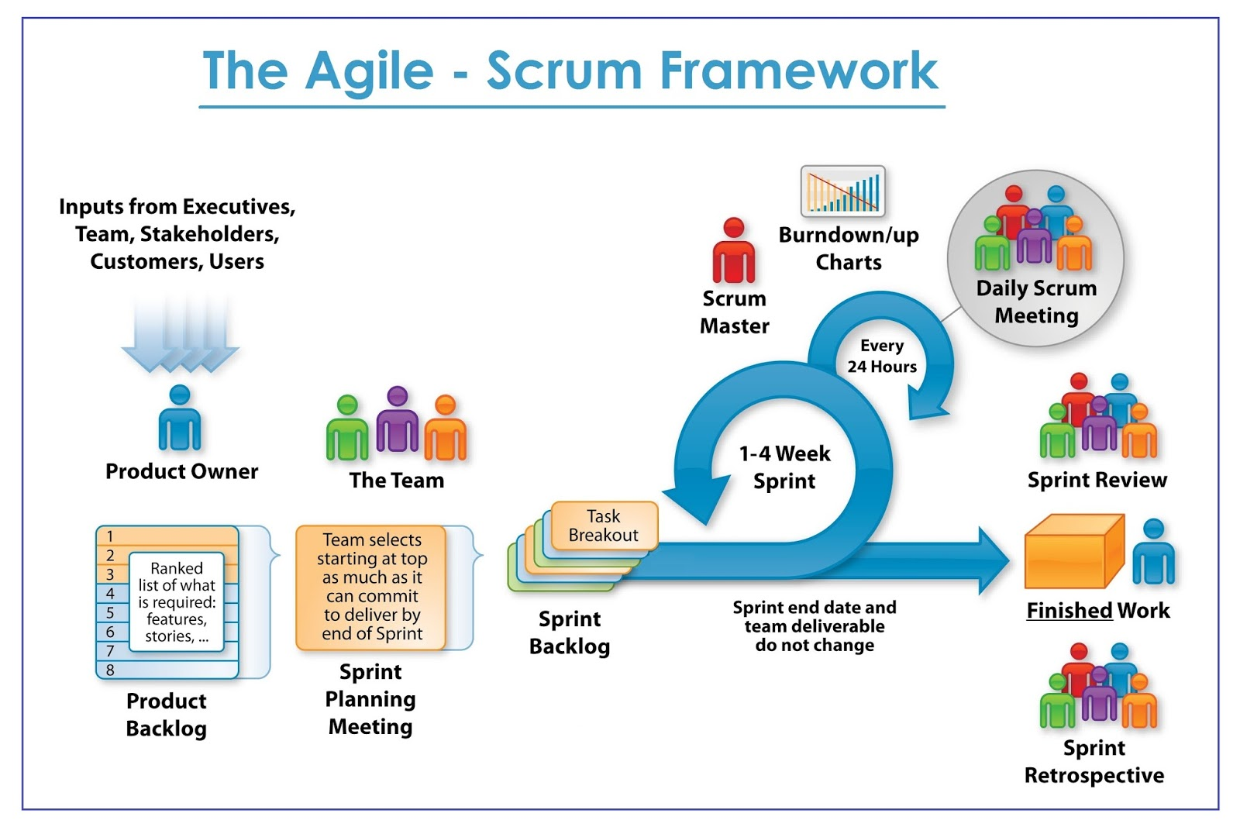

Slide 18

Scrum Framework
Roles
Product owner
Scrum Master
Team
Ceremonies
Sprint planning
Sprint review and Sprint retrospective
Daily scrum meeting
Artifacts
Product backlog
Sprint backlog
Burndown charts

Slide 19
Scrum Roles

Slide 20







Scrum Roles
Product Owner
Possibly a Product Manager or Project Sponsor
Decides features, release date, prioritization, $$$
Conveys a clear vision to the Scrum team
Replies to frequently asked queries
Scrum Master
Typically a Project Manager or Team Leader
Responsible for enacting Scrum values and practices
Remove impediments / politics, keeps everyone productive
Project Team
5-10 members; Teams are self-organizing
Cross-functional: QA, Programmers, UI Designers, etc.
Membership should change only between sprints

Slide 22
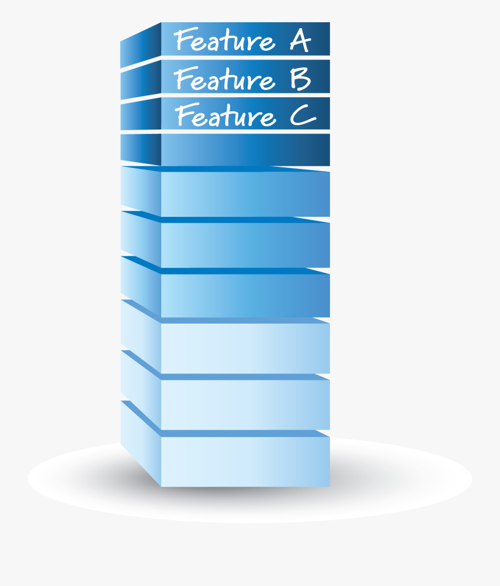
Artifact - Product Backlog
The requirements
A list of all desired work on project
Ideally expressed as a list of user stories along with "story points", such that each item has value to users or customers of the product
Prioritized by the product owner
Reprioritized at start of each sprint
This is the product backlog

Slide 23
Artifact - Product Backlog
Feature | Backlog item | Estimate
A | Allow a guest to make a reservation | 3 (story points)
B | As a guest, I want to cancel a reservation. | 5
C | As a guest, I want to change the dates of a reservation. | 3
D | As a hotel employee, I can run RevPAR reports (revenue-per-available-room) | 8
E | Improve exception handling | 8
… | ... | 30
… | ... | 50
Notes:
‹#›

Slide 25

Artifact - Sprint Backlog
High priority features are selected based on points from product backlog.
These features will be covered within that 1-4 weeks time slot called as sprint.
Estimated work remaining is updated daily
Any team member can not add, delete change sprint backlog
This is the sprint backlog
If the work turns out to be different than they expected, they collaborate with the Product Owner to negotiate the scope of the Sprint Backlog within the Sprint without affecting the Sprint Goal.

Slide 27
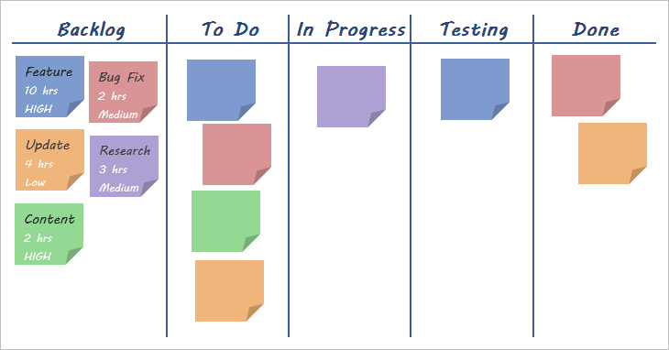
Artifact - Sprint Board

Slide 29
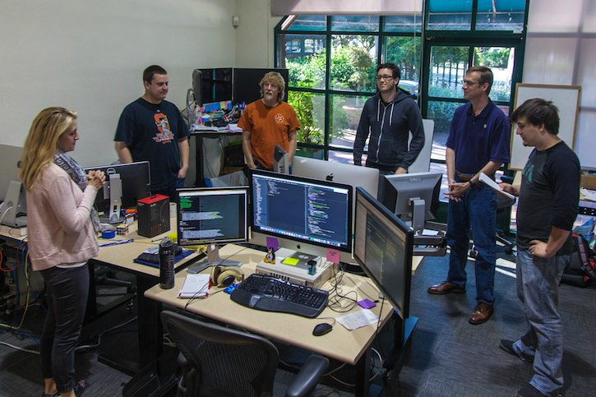
Ceremony - Daily Scrum Meeting
Parameters
Daily, ~15 minutes, Stand-up
Anyone late pays a $1 fee
Not for problem solving
Whole world is invited
Only team members, Scrum Master, product owner, can talk
Helps avoid other unnecessary meetings
Three questions answered by each team member:
What did you do yesterday?
What will you do today?
What obstacles are in your way?
Notes:
‹#›

Slide 30
Artifact – Burndown Chart
A display of what work has been completed and what is left to complete
one for each developer or work item
updated every day
(make best guess about hours/points completed each day)
variation: Release burndown chart
shows overall progress
updated at end of each sprint
2 min read: https://www.mountaingoatsoftware.com/agile/scrum/scrum-tools/release-burndown

Slide 31
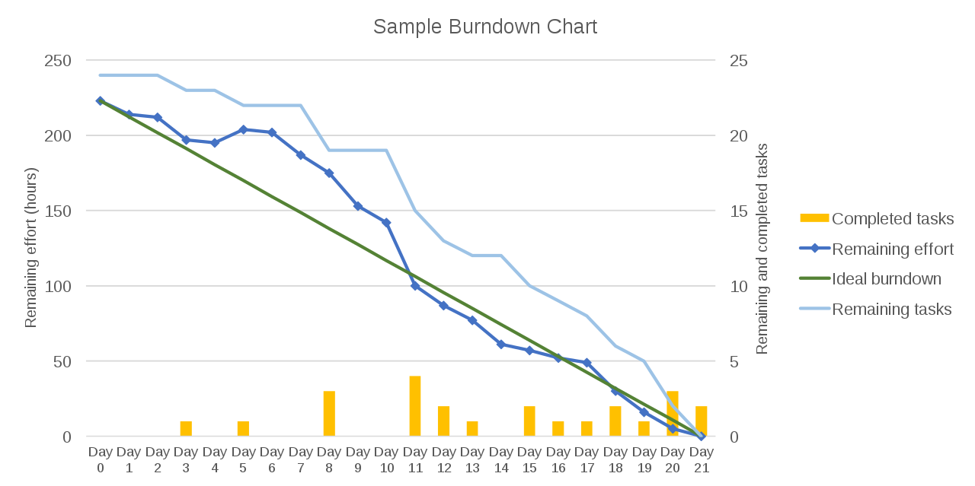
Artifact – Burndown Chart

Slide 33
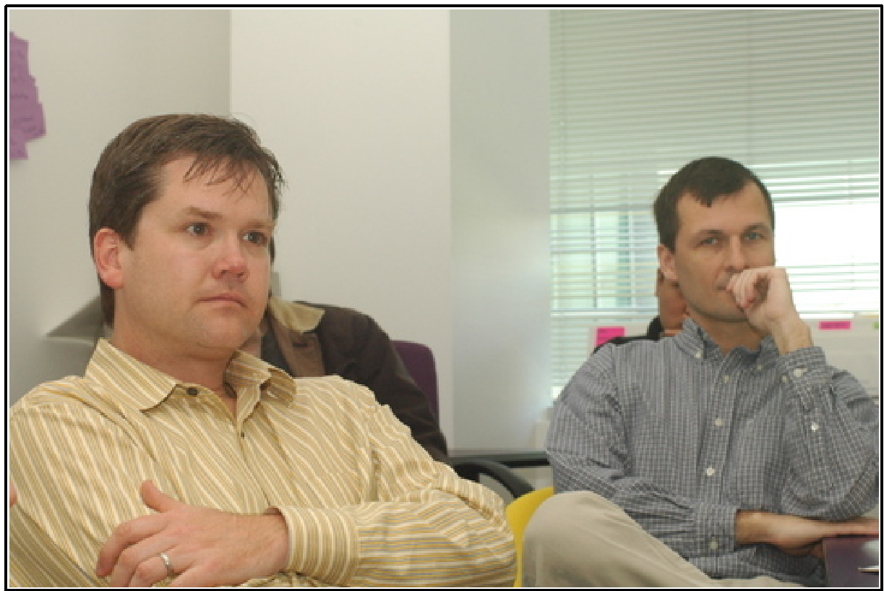
Ceremony - Sprint Review
Team presents what it accomplished during the sprint
Typically takes the form of a demo of new features or underlying architecture
Informal
2-hour prep time rule
No slides
Whole team participates
Invite the world

Slide 34
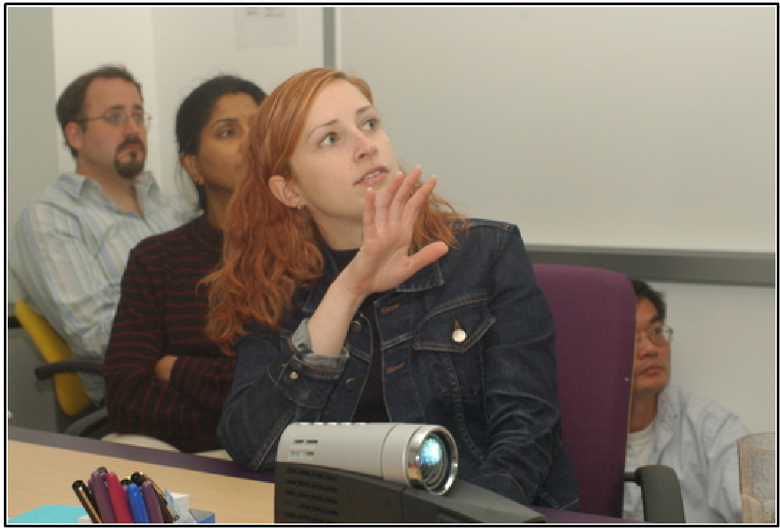
Ceremony – Sprint Retrospective
Identify the scopes of improvement for better result in next sprints
What worked well, what went wrong are also discussed
2 min read: https://www.scrum.org/resources/what-is-a-sprint-retrospective

Slide 35
Summary
We have learnt three types of agile principles used in the industry.

